Slide 1
An AI for Nash’s Hex
Jonathan Zhou and Cadence Weddle

Slide 2
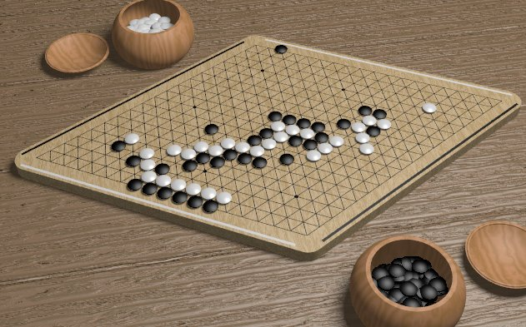
The Game of Hex

Slide 3
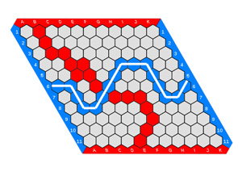
Rules of the Game of Hex
Each player get’s a color
In this case it’s Red and Blue
Players take turns placing a stone(coloring in) of their color on a single cell within the overall playing board (The stone cannot be placed on top of another player’s stone).
The goal for each player is to form a connected path of their own stones linking the opposing sides of the board marked by their colors, before their opponent connects his or her sides in a similar fashion.
The first player to complete his or her connection wins the game.
The four corner hexagons each belong to both adjacent sides.
A winning configuration for the Blue player

Slide 4
History of the Game of Hex
The game was first invented by the Danish mathematician Piet Hein
In 1942 at the Niels Bohr Institute
Although Hein called it Con-tac-tix, it became known in Denmark under the name Polygon due to an article by Hein in the December 26, 1942
The article was the first published description of the game
The game was independently re-invented by the mathematician John Nash
In 1948 at Princeton University.
Around 1950, American mathematician, Information Theorist, and Electrical Engineer Claude Shannon and E.F. Moore constructed an analog Hex playing machine
Essentially a resistance network with resistors for edges and lightbulbs for vertices
The move to be made corresponded to a certain specified saddle point in the network.
In 1952, Parker Brothers marketed a version. They called their version "Hex" and the name stuck.
In 1952 John Nash demonstrated an existence proof that on symmetrical boards, the first player has a winning strategy
In 2002, the first explicit winning strategy ono a 7x7 board was described
Throughout the 21st century, brute force computer search algorithms have been used to solve all Hex boards up to size 9x9.

Slide 5
Strategy of the Game of Hex

Slide 6
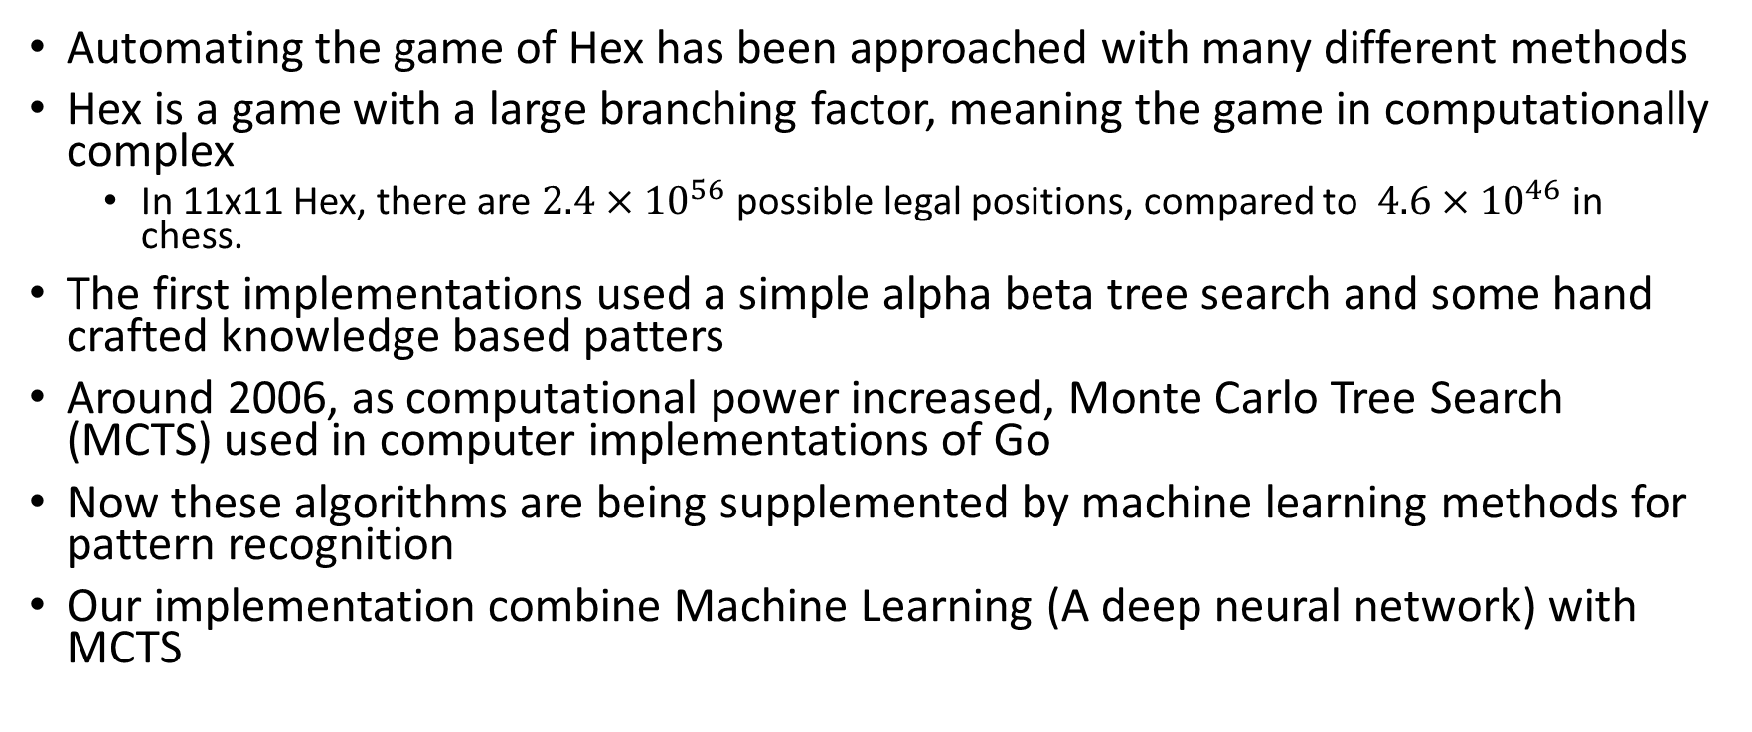
Automating the game of Hex
Automating the game of Hex has been approached with many different methods
Hex is a game with a large branching factor, meaning the game in computationally complex
In 11x11 Hex, there are $2.4×{10}^{56}$ possible legal positions, compared to $4.6×{10}^{46}$ in chess.
The first implementations used a simple alpha beta tree search and some hand crafted knowledge based patters
Around 2006, as computational power increased, Monte Carlo Tree Search (MCTS) used in computer implementations of Go
Now these algorithms are being supplemented by machine learning methods for pattern recognition
Our implementation combine Machine Learning (A deep neural network) with MCTS

Slide 7
Artificial Intelligence

Slide 8
What is Artificial Intelligence

Slide 9
Technologies used

Slide 10
Tree Searches

Slide 11
What is Tree Search?

Slide 12
The Deep Neural Network

Slide 13
Iterative Optimization

Slide 14
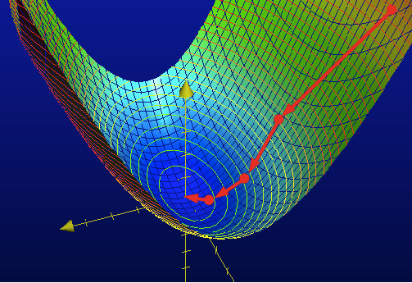
Gradient Descent

